Slide 1
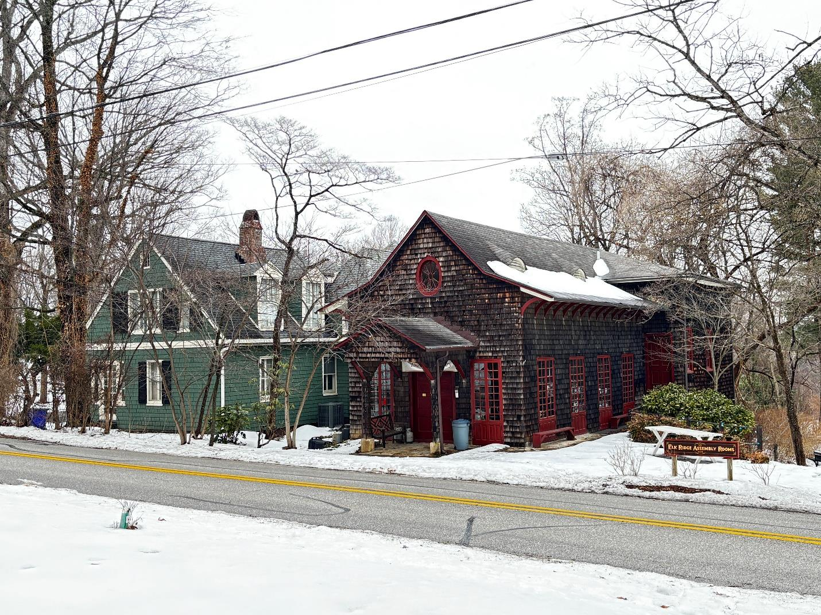
Stabilizing
the Assembly Rooms
One hundred fifty-five years standing.
The next hundred is the work in front of us.
Annual Members' Meeting
Monday, 15 June 2026 · 6:30 pm
6090 Lawyers Hill Road, Elkridge MD
The Assembly Rooms · Lawyers Hill Road · February 2026

Slide 2
Why we're here
1870 — 1871.
Judge George Washington Dobbin gives his neighbors land to build a hall — a deliberate gesture to heal a community whose loyalties had been split by the Civil War. Plays, dances, picnics, and readings replace political argument. The Assembly Rooms opens in 1871 with a production of "The Rivals."
2025 — 2026.
Programming has grown: farm pop-ups, concerts, art exhibits, a poster collection, partnerships with Morningside Farm, Rockburn Land Trust, and the Howard County Tourism Center. We expect to host more than 1,000 visitors in 2026.
The building is tired.
A wood-frame, pier-and-beam structure 155 years old has been quietly losing its battle with moisture for a long time. The 2008 stabilization slowed the decay but did not stop it. Sills are rotted. The east deck is unsafe. The crawlspace drains into itself. A temporary steel jack is currently holding part of an interior corner.
Tonight.
We're asking the membership to back a one-time stabilization of the Assembly Rooms, funded by a Maryland Heritage Areas Authority grant matched dollar-for-dollar by us, so this building can host the next hundred years of community gathering.
Elkridge Assembly Rooms · Annual Meeting · 15 June 2026
2 / 12

Slide 3
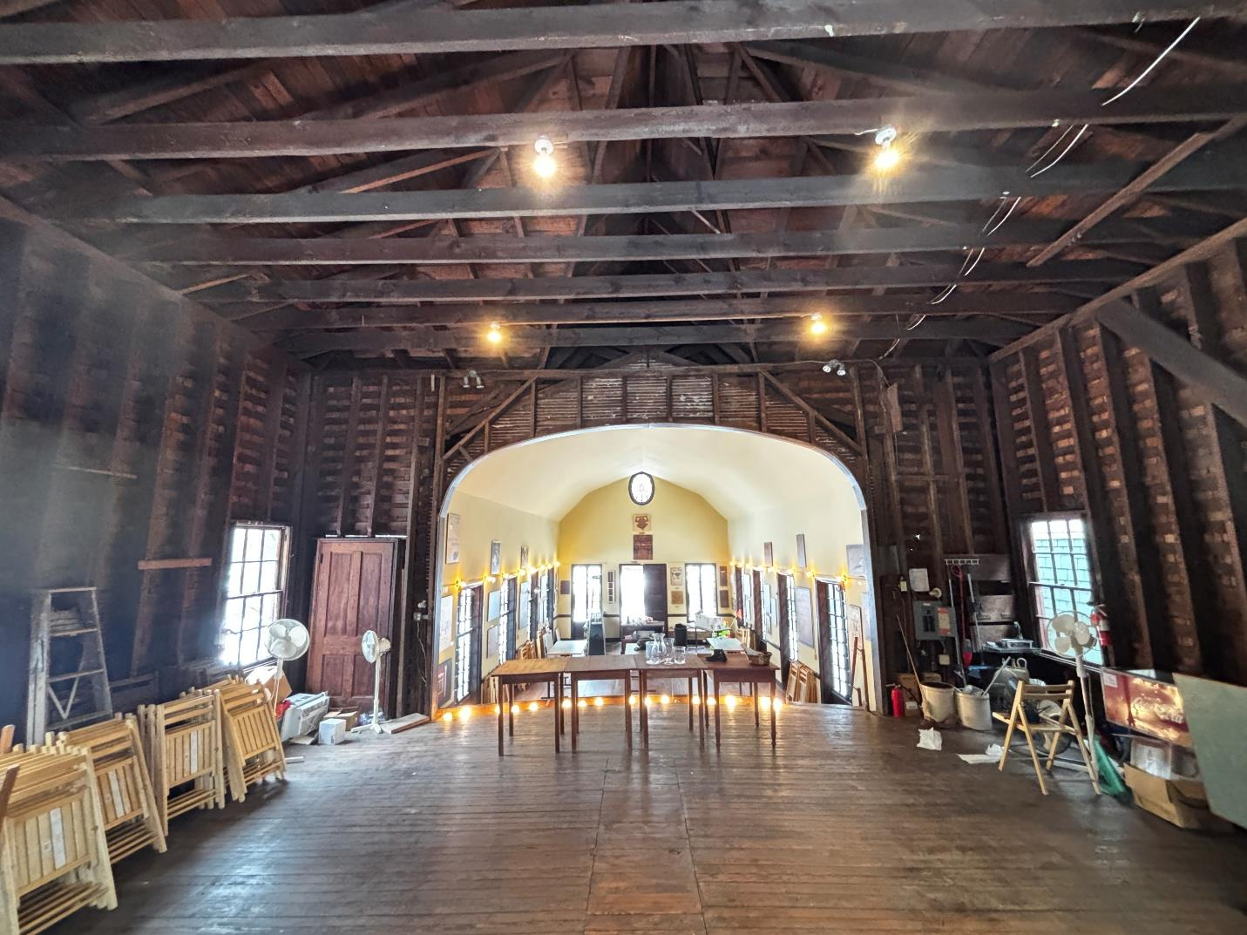
What we are saving
The stage and barrel-vaulted ceiling, looking south into the assembly room.
Designed by Washington architect Robert Stead, who also lived two doors down on Lawyer's Hill. The original Assembly Rooms burned and was rebuilt to the same form. The interior is materially unaltered: rough heavy timbers, T-and-G boards, jib windows that still open to French doors on summer nights, the same proportions audiences saw in 1871.
Maryland Historical Trust calls the Assembly Rooms "of national significance" for its post-war healing purpose and recommends inclusion (with the broader Lawyer's Hill area) in the National Register Historic District — which was listed in 1993.
Elkridge Assembly Rooms · Annual Meeting · 15 June 2026
3 / 12

Slide 4
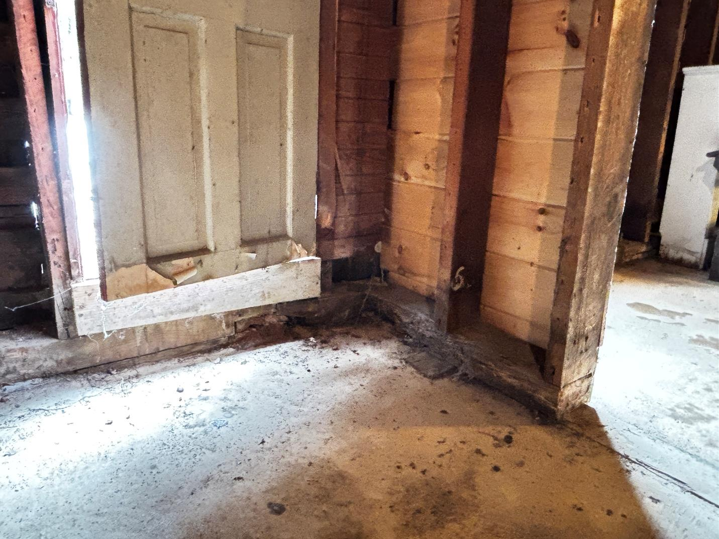
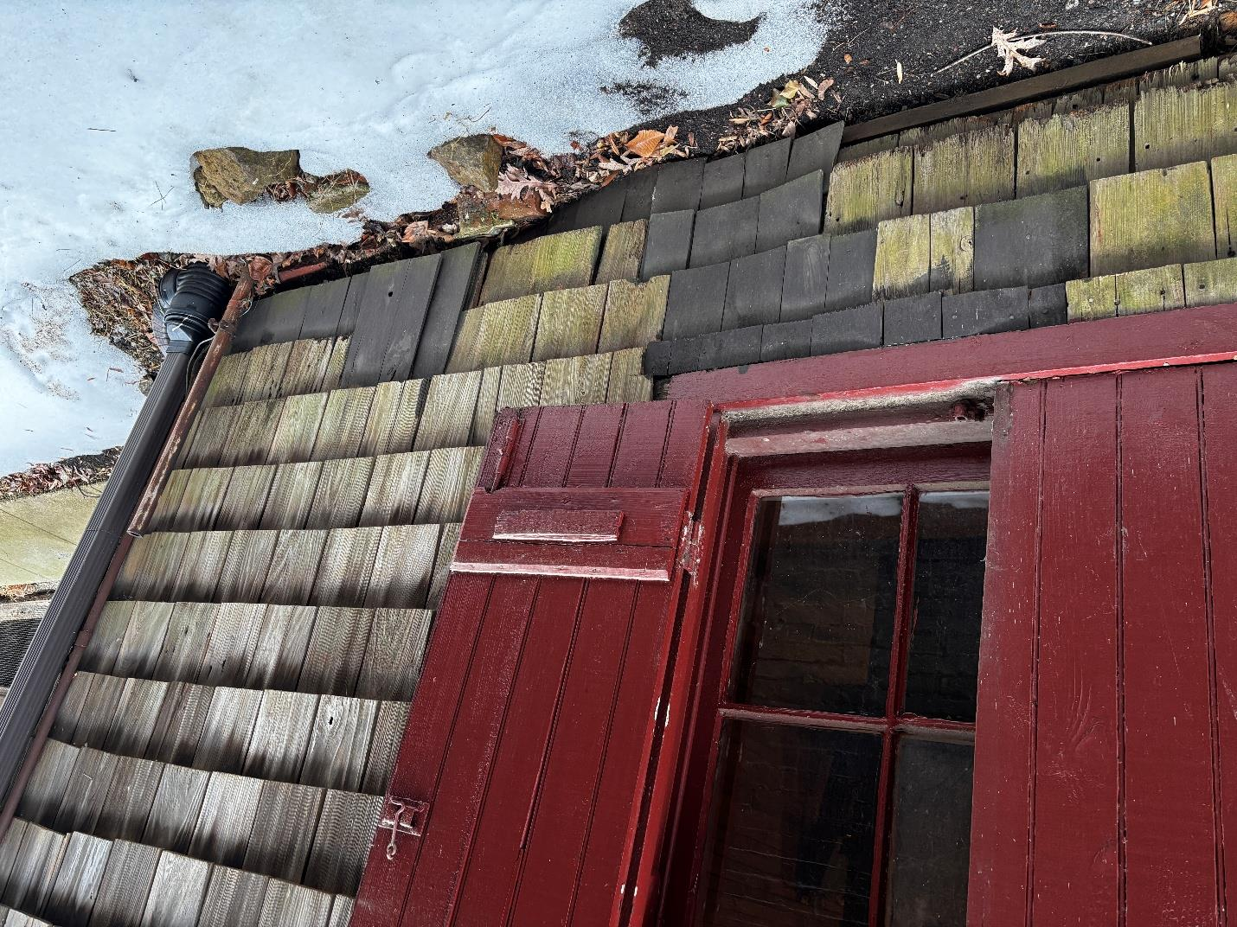
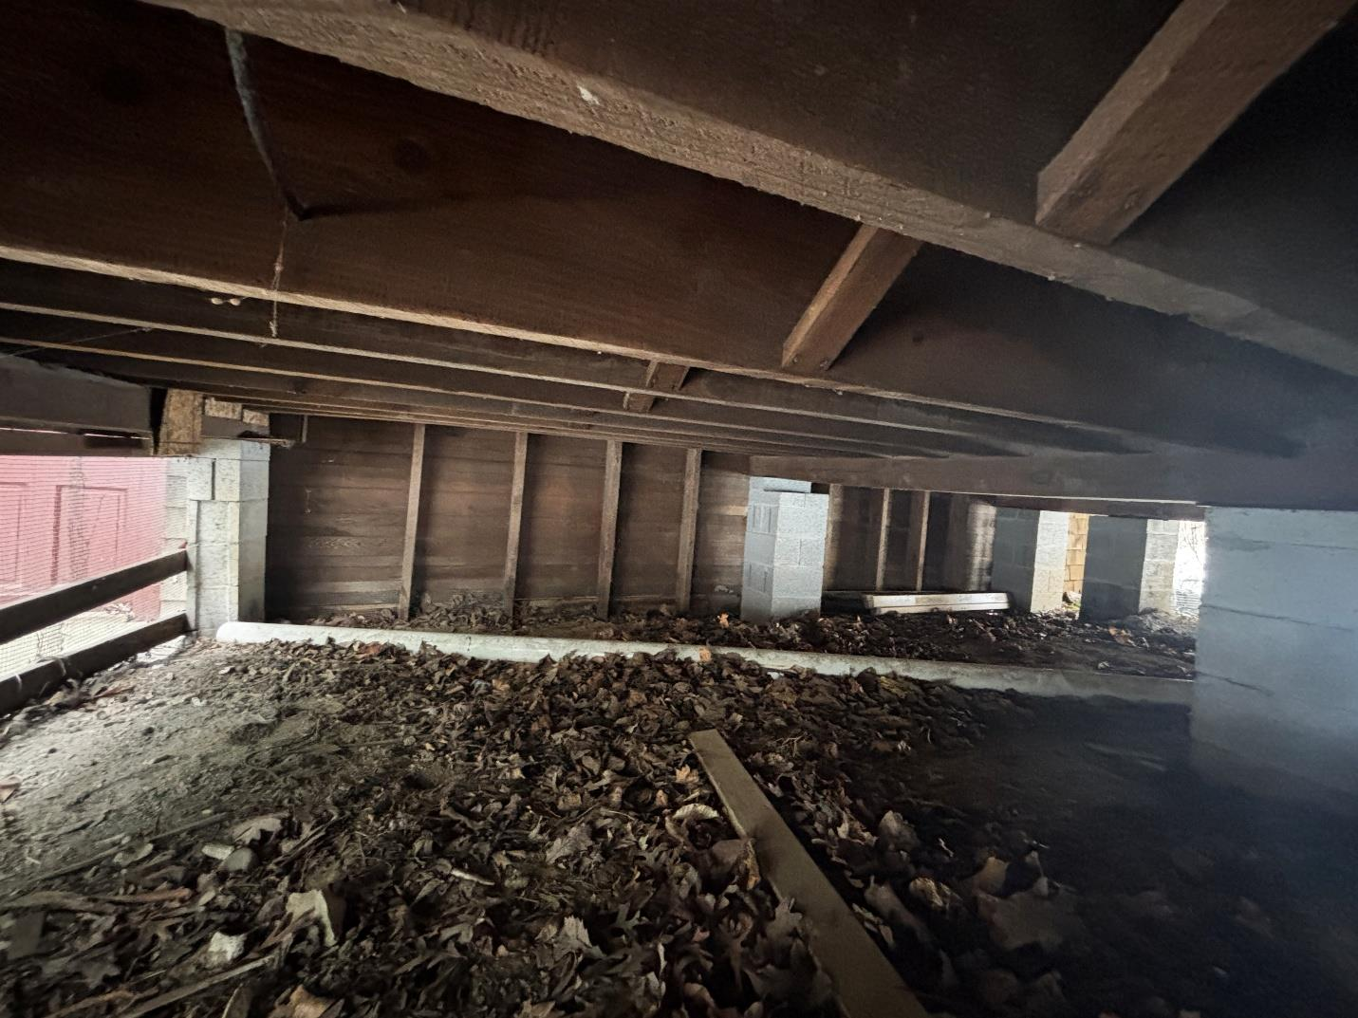
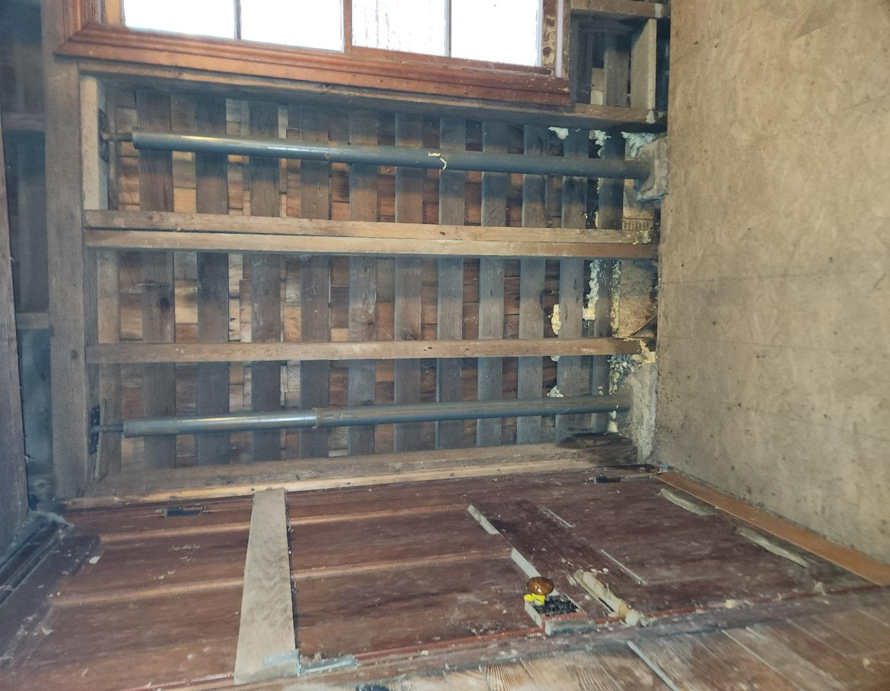
What lives below the floor we dance on
Documented by Fitzgerald's Heavy Timber Construction · Feb 2026
Rotted wood sills at the east entrance, interior. The white box is daylight where structure used to be.
Exterior west window at foundation level. Moss has colonized the lower three courses of cedar shingle.
Crawlspace under the south stage wall, looking north. Leaves and bare earth, no vapor barrier.
Interior west foundation corner. The two blue posts are temporary steel jack shores currently holding load.
Elkridge Assembly Rooms · Annual Meeting · 15 June 2026
4 / 12

Slide 5
Fitzgerald's diagnosis
Maryland-based timber-frame restoration firm, in business since 1992.
Wood sills
Selective removal; replace in white oak.
Root cause
Stage framing (SE / SW)
Sister, block, or dutchman-splice.
Wood structural members bearing directly in soil and in moisture-prone conditions.
The 2008 stabilization addressed the urgent symptoms — failing girders, foundation movement, threatened occupancy — but did not separate the building's timber from the ground it sits on. Moisture has continued to wick into sill plates and lower wall assemblies ever since.
This project breaks the cycle: lift vulnerable timber out of contact with soil, give it a defined foundation, move water away from the building.
Eastern deck
Reconstruct in historic proportions.
East stage door
Localized repair; mitigate moisture.
Site drainage (E / W)
Regrade; subsurface perimeter drain.
Gutters & downspouts
Reconnect to controlled discharge.
Shingle / flashing detail
Tighten transitions at openings.
North window shutter
Rehang; keep original hardware.
Elkridge Assembly Rooms · Annual Meeting · 15 June 2026
5 / 12

Slide 6
The scope, in order of cost
Each row is grant + match. Bar length is total project cost.
Trade
Description
Project total
Relative cost
Framing
Repair sills and stage framing
$33,428
Rigging
Support load-bearing walls during work
$19,605
Cladding
T&G boards, cedar shingles at repair points
$16,074
Concrete
Footers for south wall and deck piers
$10,280
Demolition
Selective removal: walls, shingles, concrete
$9,882
Site
Trenching, grading, subsurface drainage
$8,985
Electric
100A → 200A · heater circuits · 4 heaters
$8,719
Mobilization
Staging, haul-in, tear-down
$7,554
Masonry
Block foundation and pier construction
$6,990
Doors
Remove, install new sills, reinstall (3)
$3,303
Paint
Touch up: doors, window, shutters
$3,196
Milling
Rough-sawn boards and timbers
$3,122
Gutters
Reconnect to drainage improvements
$1,215
Windows
Rehang one pair of shutters
$1,167
All trades
$133,520
+ $3,356 in-kind volunteer time
Elkridge Assembly Rooms · Annual Meeting · 15 June 2026
6 / 12

Slide 7
The money
$68,437
$68,437
$136,874
Grant request
Match (1:1 required, dollar-for-dollar)
Total project cost
Where the match comes from
Existing reserves — $21,027
Contractor contributions — $21,027
New fundraising — $21,027
Donated materials — $2,000
Volunteer time — $3,356
The organization has enough in cash reserves to cover the full match if needed. The intent is to spread it: about one-third reserves, one-third contractor charitable contributions, one-third new community fundraising.
Elkridge Assembly Rooms · Annual Meeting · 15 June 2026
7 / 12

Slide 8
When the work happens
Off-season construction. The Assembly Rooms stays open for the 2026 program calendar and reopens for 2027.
Jul'26
Aug
Sep
Oct
Nov
Dec
Jan'27
Feb
Mar
Apr
May
Jun
Pre-construction
Construction
Reopen
Bid documents, contractor procurement, permitting, material sourcing (rough-sawn timber). 2026 event season runs concurrent — Assembly Rooms stays open.
Selective demolition, sill and framing repair, foundation, drainage, deck reconstruction, electrical. Assembly Rooms is closed.
Punch list, cleanup. 2027 season begins on schedule.
The 2027 calendar (May–Nov: Farm Pop-Ups, concerts, art exhibits, July 4th picnic, Annual Meeting) will run on schedule.
Elkridge Assembly Rooms · Annual Meeting · 15 June 2026
8 / 12

Slide 9
The people on this
All board roles volunteer; outside contractors selected for preservation experience.
Board project team
Contractors & consultants
Debra Roth
Fitzgerald's Heavy Timber Construction
President · Project Manager
Structural assessment & scope
25+ yrs program management; contractor coordination.
Thurmont, MD; in business since 1992. Traditional joinery, heavy timber systems, preservation-sensitive repair. Authored the 19-photo conditions assessment.
Dustin Thacker, Assoc. AIA
Volunteer Architect
Architect and structural consultant; former HoCo HPC.
JEM Electrical Co.
Nessly Craig, Ph.D.
Electrical scope
Project Advisor
Woodbine, MD. 100A → 200A service, dedicated heating circuits, 4 Bromic infrared heaters.
Retired UMBC Biological Sciences professor.
Burnet Chalmers
Project Advisor
Secretary of the Interior
Retired President, The Milby Company.
Standards of compliance
Wendy Ng
All work performed under the Secretary's Standards for Rehabilitation, reviewed under MHAA grant terms.
Board (former Treasurer)
Bowstring Art Studios; Howard Co. Arts Council.
Elkridge Assembly Rooms · Annual Meeting · 15 June 2026
9 / 12

Slide 10
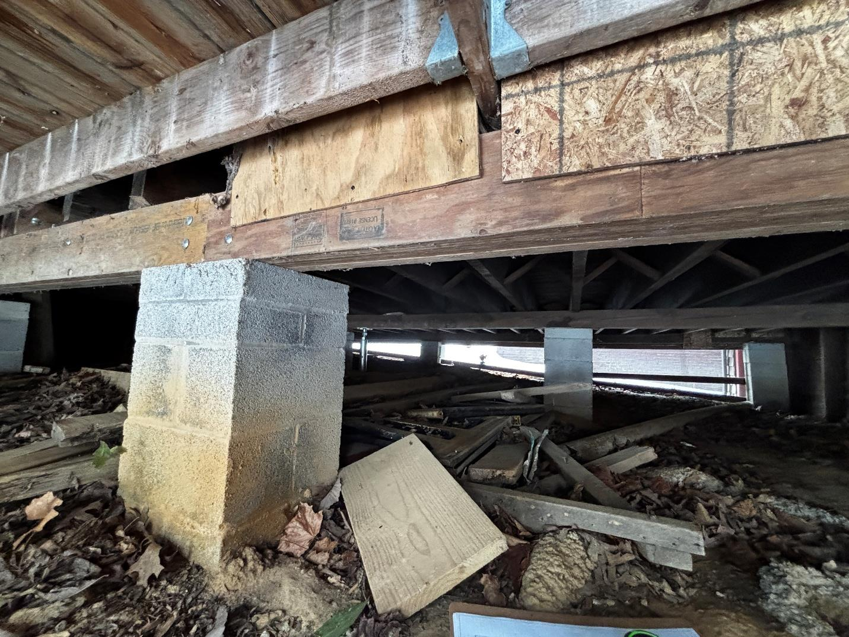
What happens if we wait
Decay accelerates. Wood members bearing on damp soil lose strength faster every winter. The east deck is already past safe public use.
Repair costs compound. Piecemeal repairs cost more in total than a single, root-cause stabilization. The 2008 work is proof — it stopped the immediate crisis but did not solve it.
Programming gets disrupted. We now host events that draw 200 people. An emergency shutdown would cancel a season and cost momentum we've spent two years building.
The historic district suffers. The Assembly Rooms is a contributing resource in the National Register Lawyers Hill Historic District. Loss or deterioration of one contributor weakens the district's integrity for everyone.
Crawlspace pier — patched. A 19th-century brick pier reinforced with concrete block. The kind of fix that has gotten the Assembly Rooms this far, but isn't the long-term answer.
Elkridge Assembly Rooms · Annual Meeting · 15 June 2026
10 / 12

Slide 11
How members can help
Give
Volunteer
Show up
We need to raise about $22,000 in new community gifts to cover one-third of the match.
Board valued at $35.53/hr per state nonprofit rate. Every committee hour is real match dollars.
Bringing one new person to an Assembly Rooms event is the single highest-leverage thing you can do.
Venmo: @Elkridge_Assembly_Rooms
PayPal Giving Fund (link on the website)
Membership: $25 individual · $50 family
Larger gifts — talk to Debra or any board member tonight
Fundraising committee
Document archiving
Event planning & hosting
Landscaping & grounds
Construction-period site monitoring (Dec '26 – Apr '27)
Annual Meeting · tonight
Farm & Coffee Pop-Ups · 2026 season
Concerts incl. Ronn McFarlane
Art exhibits incl. The Birds & The Bees (Alicia Thacker)
July 4th Picnic · hayride, lawn games
Elkridge Assembly Rooms · Annual Meeting · 15 June 2026
11 / 12

Slide 12
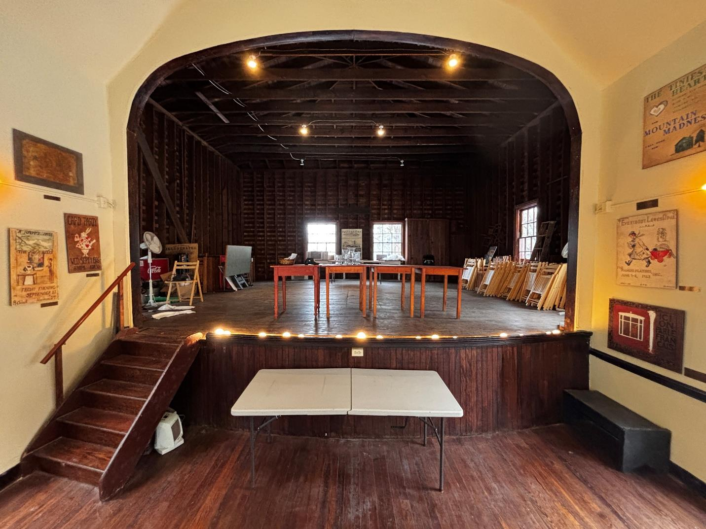
Built to heal.
Standing 155 years.
Yours to keep standing.
Thank you.
elkridgeassemblyrooms.org · @Elkridge_Assembly_Rooms

